Slide 1
ATAI
Advanced Techniqueof Artificial Intelligence
ATAI
ChongqingUniversity _{AdvancedTechniqueof}
of Technology Artificial Intelligence
Chongqing University of
Technology
Chongqing University ^{ATAI}
_{of Technology} Advanced Techniqueof
Artificial Intelligence
Chongqing University of Technology
Chongqing University of Technology
Inductive Graph Few-shot Class Incremental Learning
2025.5.19•ChongQing
—— WSDM_2025
Reported by Lele Ren
1

Slide 2
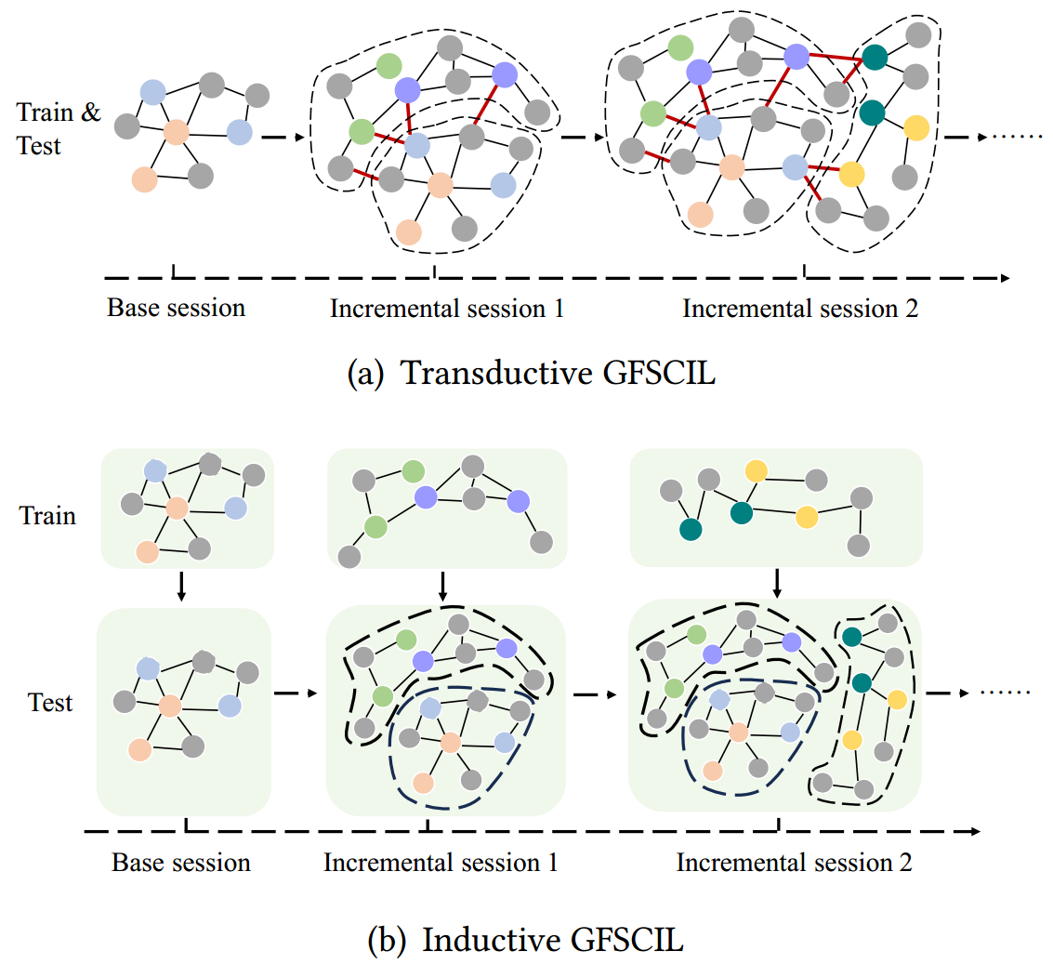
ATAI
AdvancedTechniqueof
Artificial Intelligence
ATAI
ChongqingUniversity _{AdvancedTechniqueof}
of Technology Artificial Intelligence
ChongqingUniversity of Technology
Motivation
Most existing few-shot class incremental learning methods for graphs assume that the model has access to the entire graph and learns by leveraging the global graph structure. However, newly formed subgraphs are often independent and not directly connected to previous subgraphs. Therefore, a new approach is needed to address this practical challenge.

Slide 3
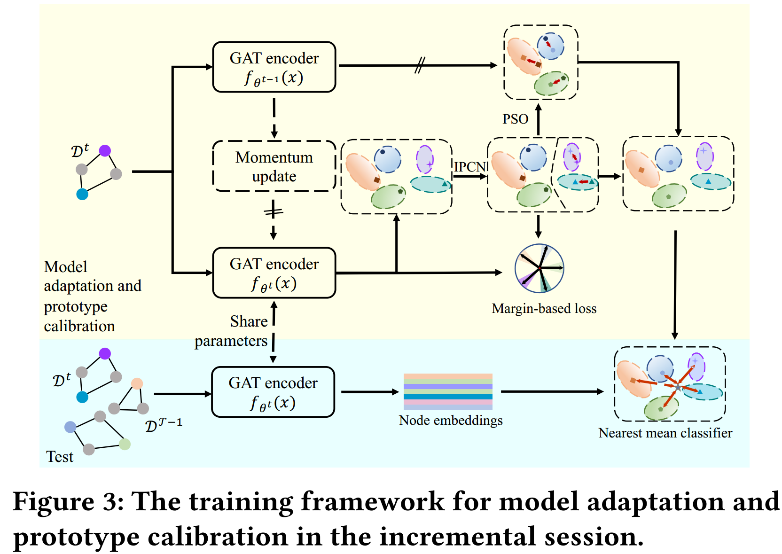
ChongqingUniversity of Technology
ATAI
AdvancedTechniqueof
Artificial Intelligence
ATAI
ChongqingUniversity _{AdvancedTechniqueof}
of Technology Artificial Intelligence
Overview

Slide 4
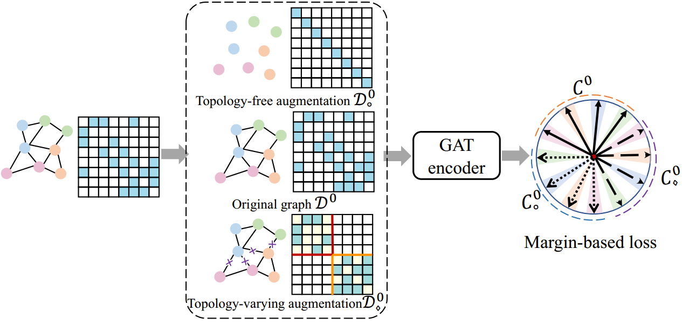
ChongqingUniversity of Technology
ATAI
AdvancedTechniqueof
Artificial Intelligence
ATAI
ChongqingUniversity _{AdvancedTechniqueof}
of Technology Artificial Intelligence
Method

Slide 5
ChongqingUniversity of Technology
ATAI
AdvancedTechniqueof
Artificial Intelligence
ATAI
ChongqingUniversity _{AdvancedTechniqueof}
of Technology Artificial Intelligence
Method

Slide 6
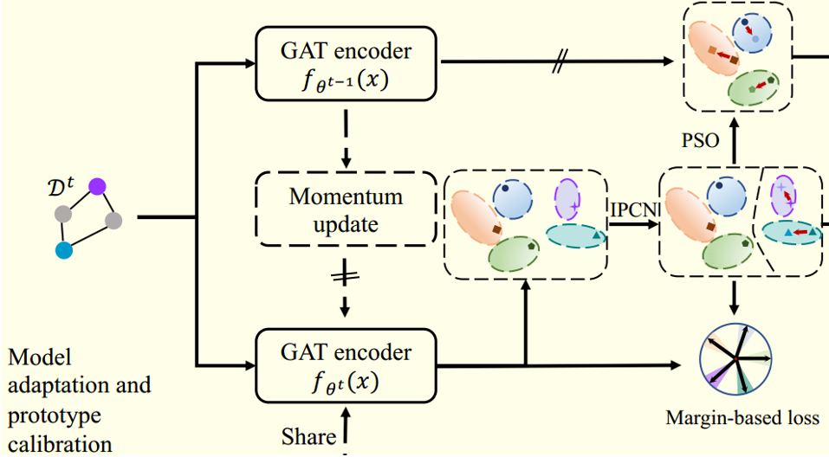
ChongqingUniversity of Technology
ATAI
AdvancedTechniqueof
Artificial Intelligence
ATAI
ChongqingUniversity _{AdvancedTechniqueof}
of Technology Artificial Intelligence
Method

Slide 7
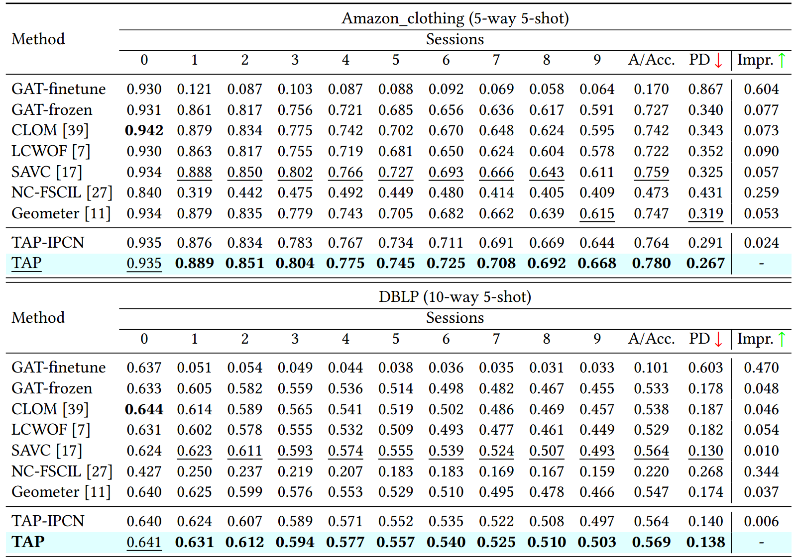
ATAI
AdvancedTechniqueof
Artificial Intelligence
ATAI
ChongqingUniversity _{AdvancedTechniqueof}
of Technology Artificial Intelligence
ChongqingUniversity of Technology
Experiments

Slide 8
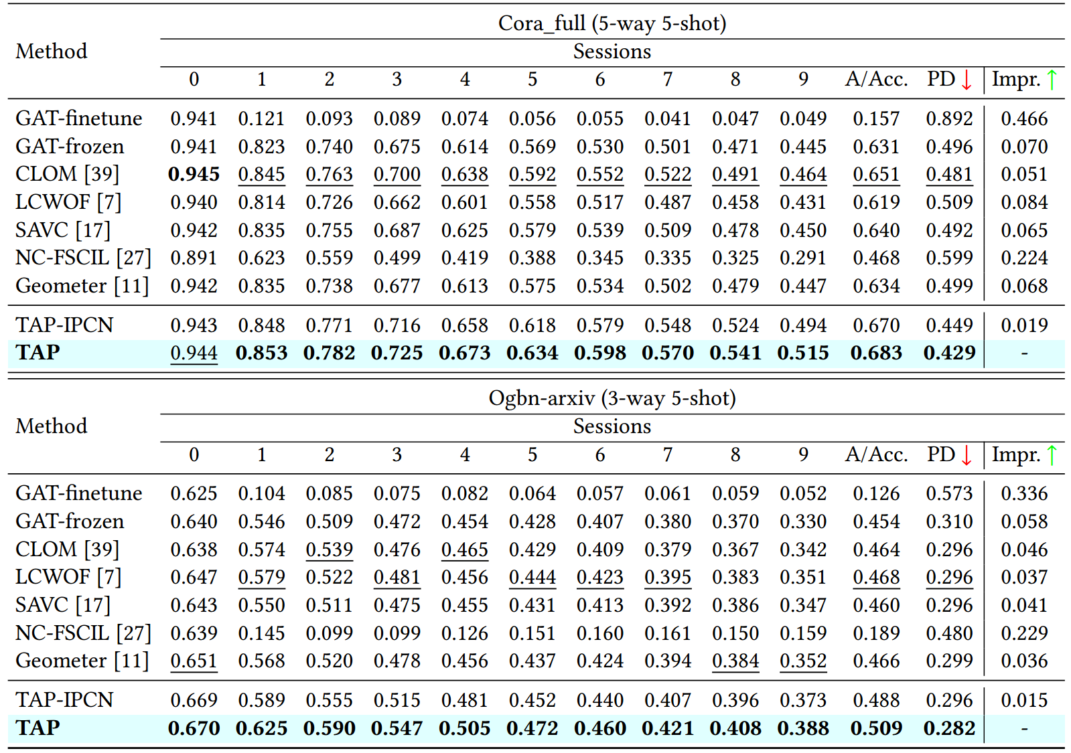
ATAI
AdvancedTechniqueof
Artificial Intelligence
ATAI
ChongqingUniversity _{AdvancedTechniqueof}
of Technology Artificial Intelligence
ChongqingUniversity of Technology
Experiments

Slide 9
ATAI
AdvancedTechniqueof
Artificial Intelligence
ATAI
ChongqingUniversity _{AdvancedTechniqueof}
of Technology Artificial Intelligence
ChongqingUniversity of Technology
Experiments

Slide 10
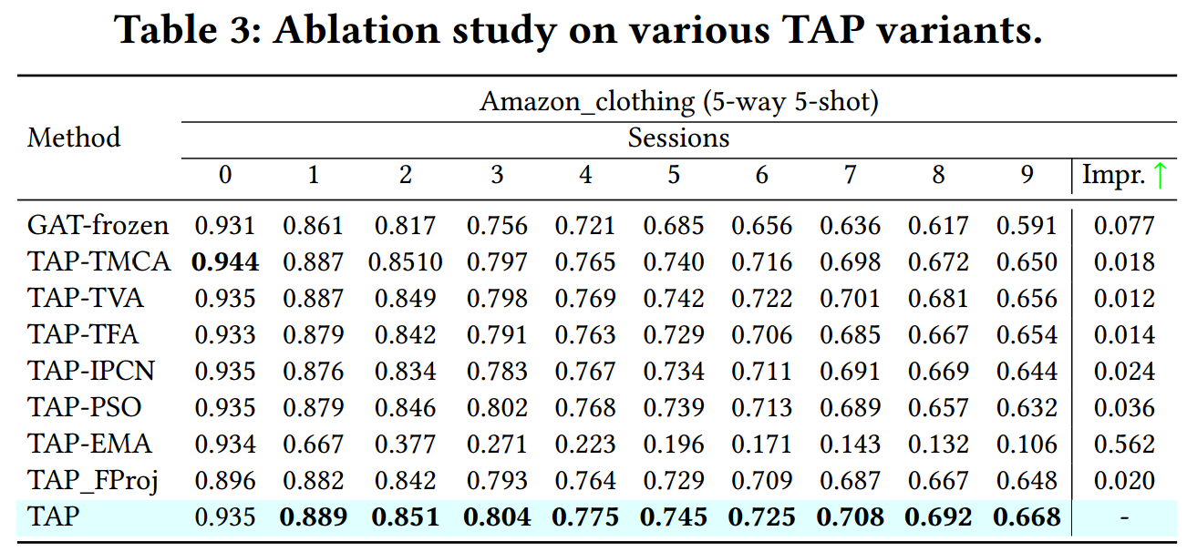
ATAI
AdvancedTechniqueof
Artificial Intelligence
ATAI
ChongqingUniversity _{AdvancedTechniqueof}
of Technology Artificial Intelligence
ChongqingUniversity of Technology
Experiments

Slide 11
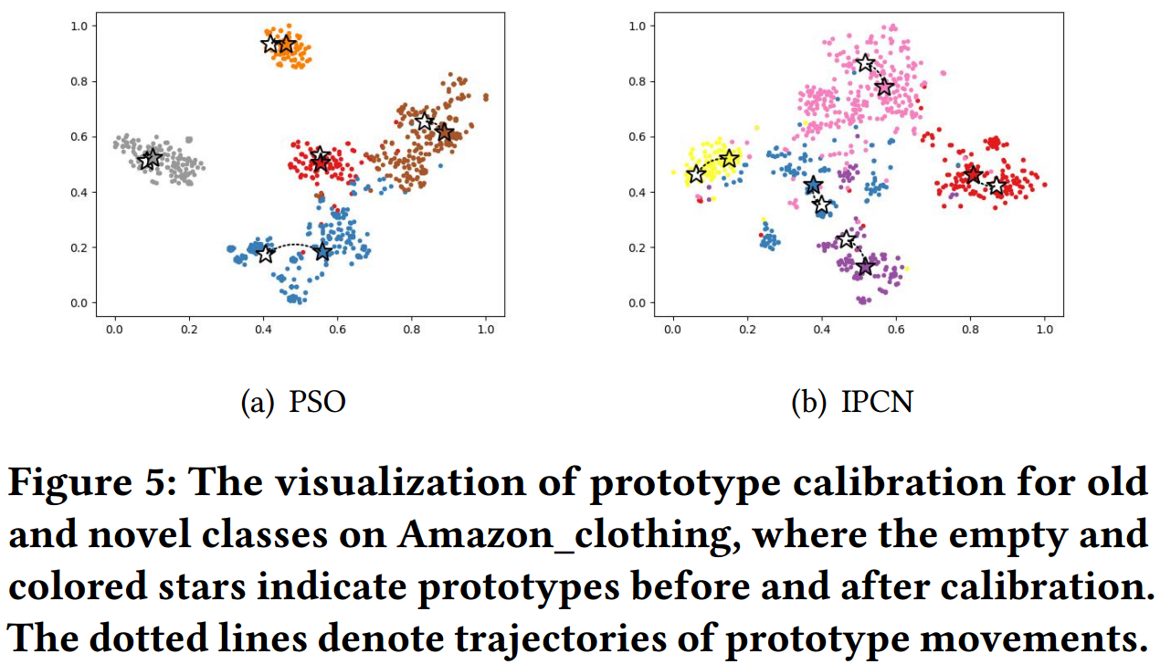
ATAI
AdvancedTechniqueof
Artificial Intelligence
ATAI
ChongqingUniversity _{AdvancedTechniqueof}
of Technology Artificial Intelligence
ChongqingUniversity of Technology
Experiments

Slide 12
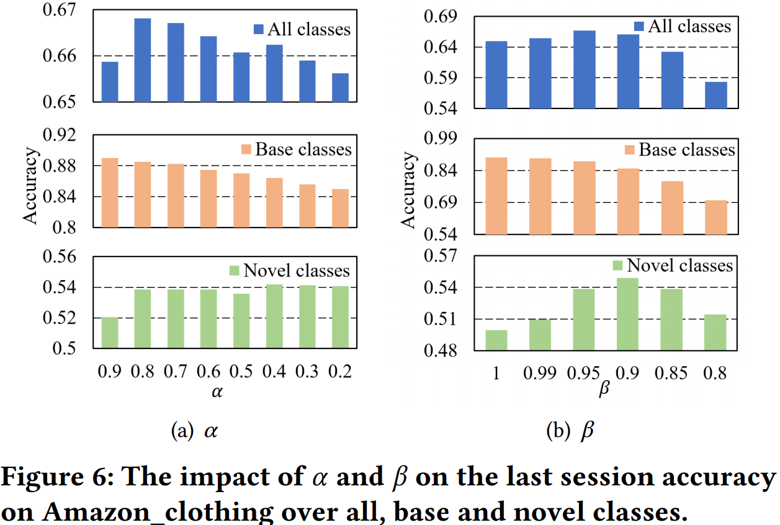
ATAI
AdvancedTechniqueof
Artificial Intelligence
ATAI
ChongqingUniversity _{AdvancedTechniqueof}
of Technology Artificial Intelligence
ChongqingUniversity of Technology
Experiments

Slide 13
ChongqingUniversity of Technology
ATAI
AdvancedTechniqueof
Artificial Intelligence
ATAI
ChongqingUniversity _{AdvancedTechniqueof}
of Technology Artificial Intelligence
Thanks!

